Slide 1
Tennis Shot Identification with computer vision
BoomStats RFP

Slide 2

High Growth Global AI focussed Blockchain enabled
BoomStats is an Australian sportstech company bringing AI-driven insights to sports. We use computer vision to analyze sports videos, extracting player movements, actions, and stats. This is enriched with private inputs like heart rate and performance data from smart insoles. Powered by Web3 and open data marketplaces, it helps analysts, coaches, and athletes improve performance and simplify video analysis. Currently working with tennis, we are expanding to football (soccer) and rugby in 2025, with plans for other sports in the future.

Slide 3
Summary
Develop a solution that identifies player court positioning and shot types during tennis matches using computer vision. The system will process timestamped data and video inputs, outputs a JSON file with rallies and shots within identified.

Slide 4
Identifications
Court positions: Defensive, Neutral & Attacking
Shot types:
Serve
Forehand Cross
Forehand Line
Forehand Inside Out
Forehand Inside In
Backhand Cross
Backhand Line
Unknown

Slide 5
Inputs
Fixed angle and height behind the court video of full match
Examples
https://drive.google.com/file/d/1eGAWk60xyzD8ZX7gVS9l0xxe9RDMsPB6/view?usp=drive_link
https://drive.google.com/file/d/1nMkZKVPKR3AQHcwQMCSpi8OtkWhIzPGO/view?usp=drive_link
https://drive.google.com/file/d/1A2tBOd3GBBpD7muCG2666_ad3ArUIeK-/view?usp=drive_link
All games will be 1 vs 1, no paired or team matches
Point start and point end timestamps from manual tagging
(in phase 2 this will be AI)

Slide 6
Training data
20 video clip examples of each type of shot
10 from player A (closer to the camera with back towards the PoV)
10 from player B (farther from the camera with face towards the PoV)
More can be provided on request

Slide 7
Output
JSON file with both players positions and shot types in each shot in rallies array
Array of rallies with array of shots inside

Slide 8
Success Criteria
Identify court position accuracy: 90+%
Shot identification accuracy 90+%

Slide 9
RFP deliverables
Timeline & expected delivery date
Cost to build and deploy
Operational cost estimates
Inference per hour or per match
Data transfer costs for video
Cost estimates for maintenance, licensing or other
Summary of the approach to the task, and larger challenges expected
Expertise and references
Cloud env preference if any
BoomStats is AWS native, Tennis client is in Azure

Slide 10
Contact
Robert Pallas, CTO @ BoomStats
+372 58 134 999
rob@robert.bz
@robertpallas (Telegram)
https://www.linkedin.com/in/robert-pallas/

Slide 11
Following this line are extra details on JSON and tennis

Slide 12
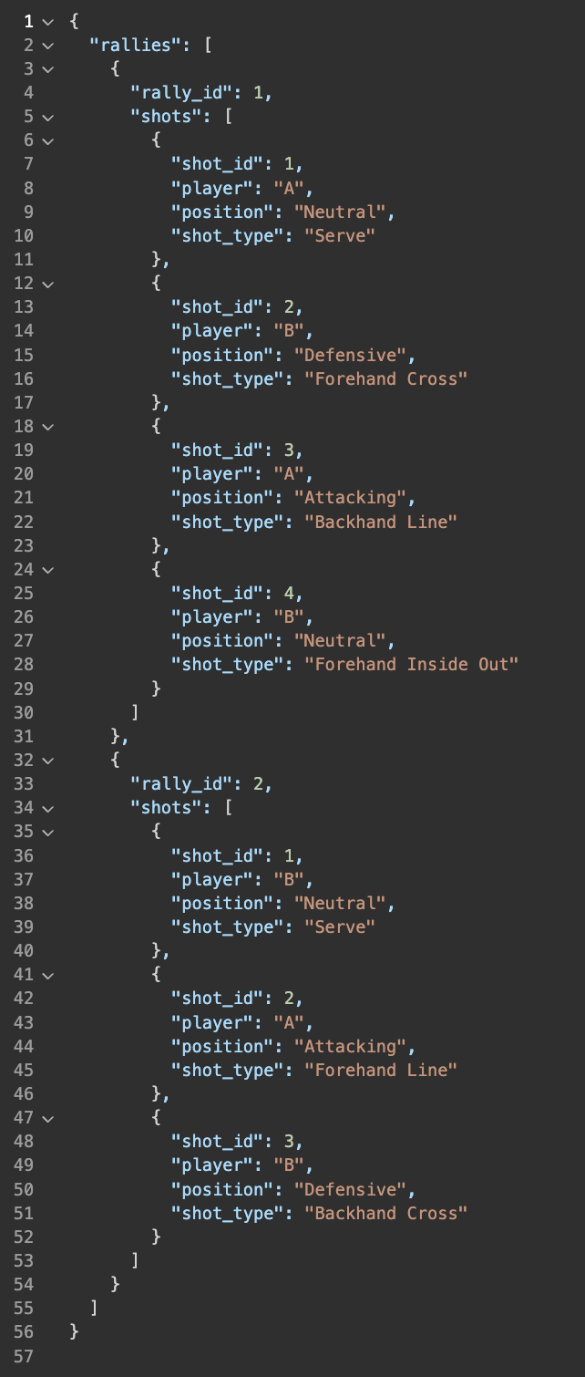
Example JSON
{
"rallies": [
{
"rally_id": INTEGER, // Unique identifier for each rally
"shots": [ // Array of shots within the rally
{
"shot_id": INTEGER, // Unique identifier for each shot within the rally
"player": STRING, // Player identifier, e.g., "A" or "B"
"position": STRING, // One of: "Defensive", "Neutral", "Attacking"
"shot_type": STRING // Type of shot, e.g., "Serve", "Forehand Cross", etc.
},
...

Slide 13
JSON Definitions: Rally
A rally in tennis refers to the sequence of continuous shots exchanged between two players starting from the serve until the point is concluded. A rally ends when:
The ball lands out of bounds.
A player fails to return the ball over the net.
A shot is hit into the net.
A winning shot (e.g., an unreturnable hit) is made.
Key characteristics of a rally:
Begins with a serve.
Involves multiple shots exchanged back and forth.
Represents the tactical and strategic interactions between players.

Slide 14
JSON Definitions: Shot
A shot in tennis refers to a single action where a player strikes the ball with their racket during a rally. Each shot is defined by:
The type of stroke used (e.g., forehand, backhand, serve).
The trajectory of the ball (e.g., cross-court, down the line).
The player's position on the court (e.g., defensive, neutral, attacking).
A shot is an atomic unit of a rally. Players take turns striking the ball, one shot at a time, in an alternating sequence.

Slide 15
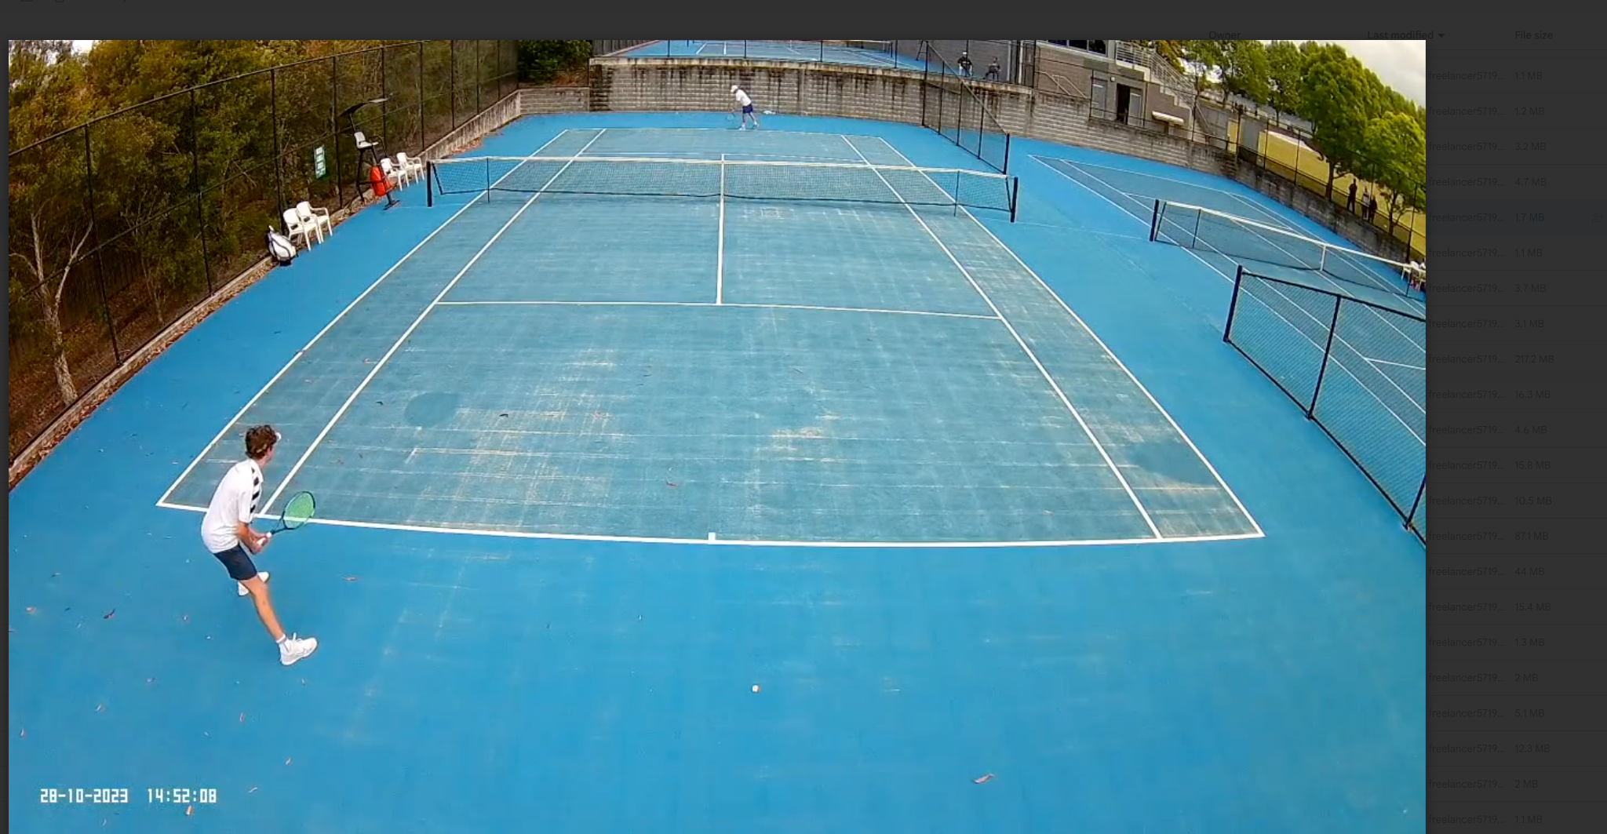
Court positions
Attacking position
Neutral position
Defensive position
Confidential

Slide 16
Shot ID
Serve
The only shot that starts with the player throwing the ball into the air from their hand.
The player hits the ball from behind the baseline into the opponent's service box to begin the rally.
Forehand Cross
A forehand shot (using the player's dominant hand side) played from the same side of the court as the hitting arm.
The ball travels diagonally across the net to the opponent's side on the opposite side of the court.
Forehand Line
A forehand shot played from the same side of the court as the hitting arm.
The ball travels straight along the sideline or closer to the center, toward the right-hand side of the opponent's court for a right-handed player.
Forehand Inside Out
A forehand shot played from the opposite side of the player's hitting arm (the backhand side of the court).
The ball travels diagonally to the opponent's side, heading to the right for a right-handed player.
Both feet of the player should be on the left side of the center mark.

Slide 17
Shot ID 2
Forehand Inside In
Played from the same position as Forehand Inside Out (on the backhand side of the court).
The ball travels straight or diagonally to the opponent's left side of the court for a right-handed player.
Backhand Cross
A backhand shot (using the opposite hand side of the body) played from the backhand side of the court.
The ball travels diagonally across the net to the opponent's side on the opposite side of the court.
Backhand Line
A backhand shot played from the backhand side of the court.
The ball travels straight along the sideline or closer to the center, toward the left-hand side of the opponent's court for a right-handed player.
Unknown
A tag used when a shot cannot be confidently classified into any specific category.
Includes:
Mishits that fail to reach the opponent’s court.
Shots with unclear intent (e.g., net hits, shanked balls).
Better to tag something as "Unknown" than to make an incorrect classification, especially when the shot does not align with any defined type or is ambiguous in trajectory and execution.

Slide 18
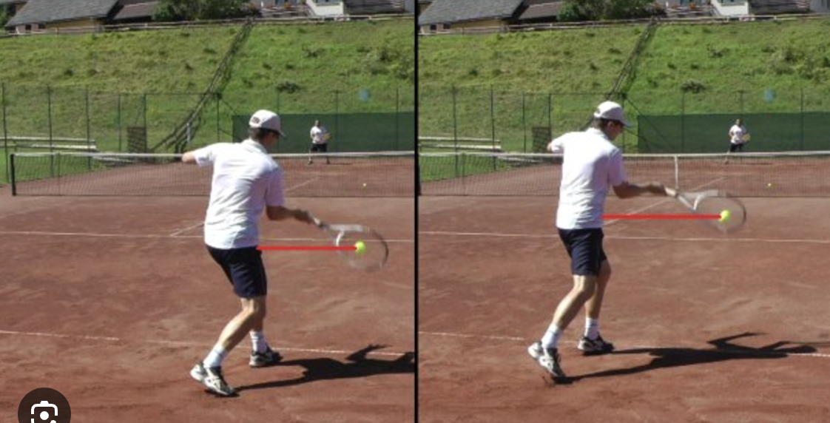
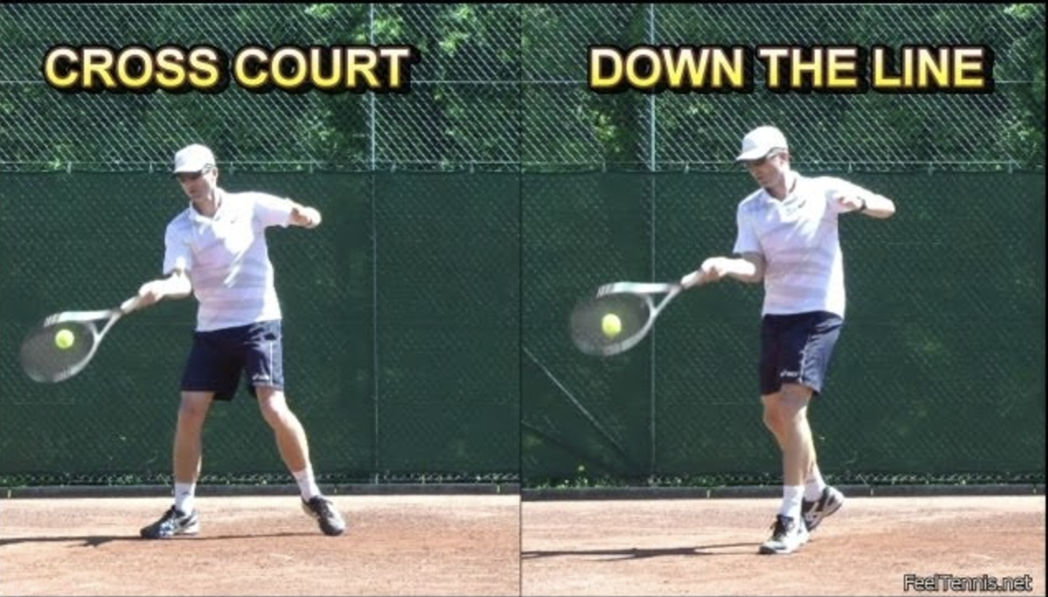
Shot Identification:
For eg: Forehand cross – forehand played from the forehand side of the court. Ball trajectory is to the left for a RH.
It is difficult to differentiate the cross court shot from the down the line.
Mitigation: Pose AI
Racquet height - cross court is higher vs lower angle on the down the line shot
Hip direction - open hip stance for cross court - closed for down the line
Shoulder direction - cross court is more open
Head direction - head will generally point in the direction of the shot
Completion of the shot - where do the shoulders, head and hips point?
It is difficult to differentiate the cross court shot from the down the line.
Mitigation:
Identify the court markings/borders
Divide the court using central line
Ball tracking to identify ball trajectory
Ie. Did the ball cross the court from bottom right to top left
Confidential

Slide 19
Lefty, righty
In tennis, shot identification is inherently tied to a player's dominant hand, which determines the orientation of forehand and backhand strokes. Right-handed players use their right hand as their dominant hand, while left-handed players use their left. This distinction has a significant impact on how shot types like cross-court, down the line, inside-out, and inside-in are classified.
For instance:
A forehand cross for a right-handed player travels to the left side of the opponent's court, but for a left-handed player, the same shot travels to the right.
Similarly, a backhand line for a right-handed player moves toward the opponent's left, while for a left-handed player, it heads to the opponent's right.

Slide 20
Player perspective
In tennis, one player (Player A) is closer to the camera with their back facing it, while the other (Player B) is farther away and facing the camera, with the net between them.
Perspective and Distance Factors
Player A (Closer): Appears to move more aggressively due to proximity.
Player B (Farther): Movements appear subtler, and shots may seem shorter due to distance distortion.
Model Adjustments
Normalize movements and positions for distance.
Adjust for perspective distortion to ensure accurate shot and position identification.

